Slide 1
Explain
As concisely as possibly ,
describe the following concepts.

Slide 2
What are the only two allowable child elements for the html tag?
For example, if the question was
You would verbalize “head” and “body”

Slide 3
"Semantic HTML"

Slide 4
What's a doctype do?

Slide 5
Explain the difference between cookies, sessionStorage and localStorage.

Slide 6
What is the difference between a block level and inline element?
What are examples of each?

Slide 7
Explain what it means for a site to be “responsive”.
What is a method for making a site responsive?

Slide 8
What's the difference between standards mode and quirks mode?
What browsers have a “quirks mode”?

Slide 9
Name some of the new HTML5 elements.
What are some of the new HTML5 features?

Slide 10
You have a slow loading html page. What are some things you could do to increase performance?

Slide 11
Fix me.
Verbalize what you would do to fix the following issues.

Slide 12
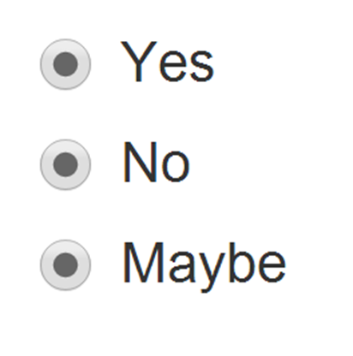
Only one should ever be selected.

